Slide 1
Index
Serial | Topic Name | Category | Slide no.
1 | Basic form building | HTML CSS | 4
2 | Related Select | HTML CSS | 7
3 | Form save as draft | HTML CSS | 8
4 | HTML5 Form Elements | HTML CSS | 10
5 | Bootstrap Component | Bootstrap | 14
6 | Javascript & Jquery Component | Javascript & Jquery | 16
7 | Arithmetic inside form using javascript | Javascript & Jquery | 20
8 | Select2 / Autocomplete plugins for dropdown list | Javascript & Jquery | 21
9 | Show/hide portion of form conditionally | Javascript & Jquery | 22
10 | ViewerJS | Javascript & Jquery | 23
11 | Ajax | Ajax | 24
12 | Image/File uploading using Ajax | Ajax | 25
13 | Text Editor- TinyMCE | Online Editor | 26
14 | Captcha | Plugins | 27
15 | External HTML Component - Font Awesome | Font Awesome | 28
16 | HTTP Response Status & Messages | Response code | 29
17 | Dynamic PDF Building using PHP (mpdf or dompdf) | Export PDF | 30
18 | Session | Session | 32
19 | Database Operations | Database | 33
20 | Different types of email sending (With attachment cc, bcc). | Email | 34
21 | Data tables plugins | Datatable | 35
22 | Access Control for different types of user | Authorization | 36
23 | Other Components |  | 37

Slide 2
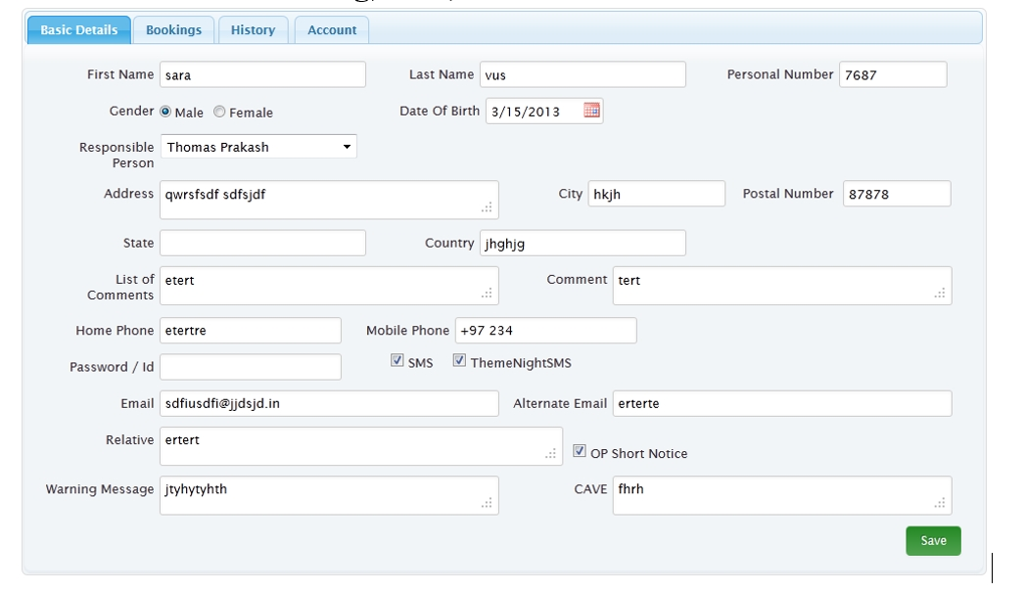

Basic form building
An HTML form contains form elements.
Form elements are different types of input elements, like text fields, checkboxes, radio buttons, submit buttons, and more
i. https://www.tutorialspoint.com/laravel/laravel_forms.htm
ii. https://www.sitepoint.com/crud-create-read-update-delete-laravel-app/

Slide 3
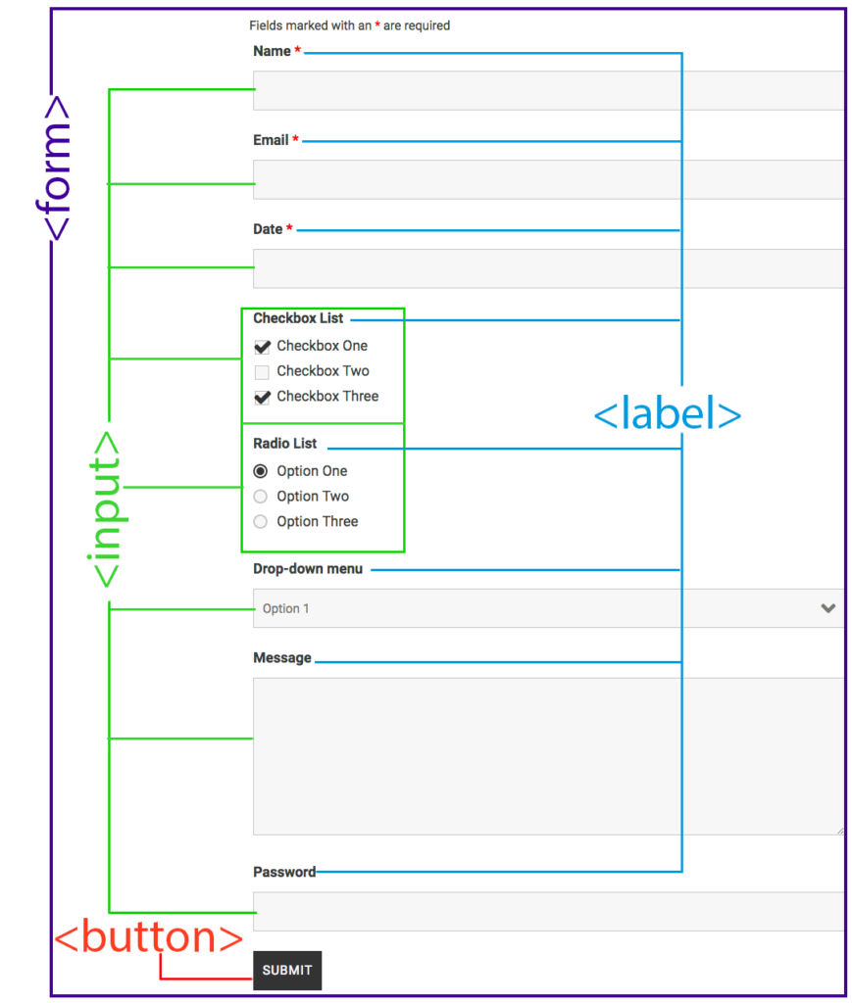
Basic form building
An HTML form contains form elements.
Form elements are different types of input elements, like text fields, checkboxes, radio buttons, submit buttons, and more

Slide 4
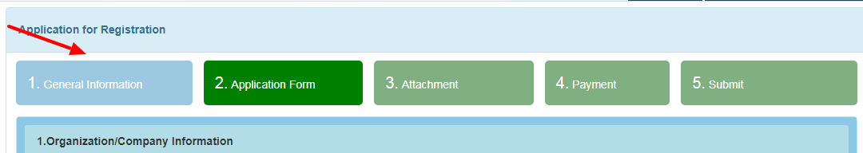


Tabs for a big form
Basic form building
If there is any big form, we need to show the form step by step. There can be several types of information also.
In this regard, we need to break the form in multiple tabs or in multiple steps for doing the application
user-friendly.
https://www.w3schools.com/howto/howto_js_tabs.asp
https://www.w3schools.com/howto/howto_js_form_steps.asp
i. https://www.tutorialspoint.com/laravel/laravel_forms.htm
ii. https://www.sitepoint.com/crud-create-read-update-delete-laravel-app/

Slide 5
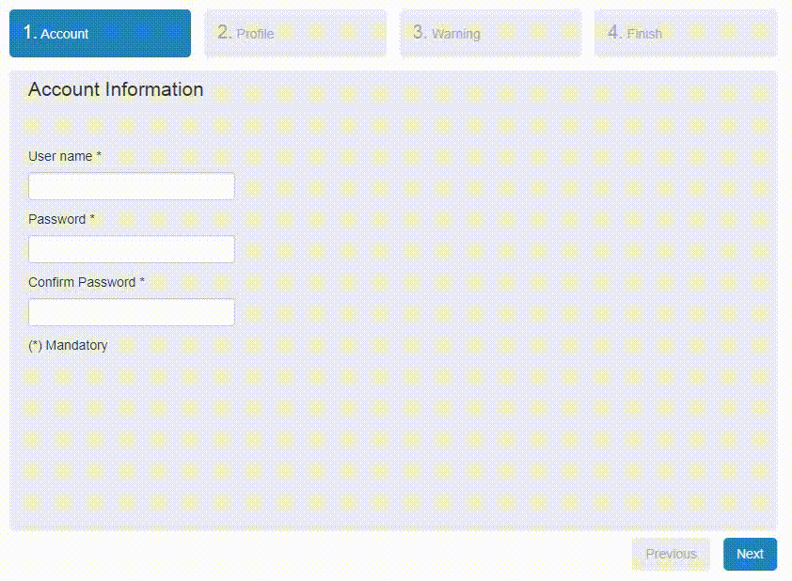
Javascript & Jquery Component
jQuery Steps :
jQuery Steps is a smart UI component which allows you to easily create wizard-like interfaces. This plugin groups content into sections for a more structured and orderly page view. Furthermore, it is as simple as 1-2-3 to add plugins such as jQuery Validation which can prevent step changing or submission. Check out the demos and get a first-hand impression!
http://www.jquery-steps.com/
http://www.jquery-steps.com/Examples

Slide 6
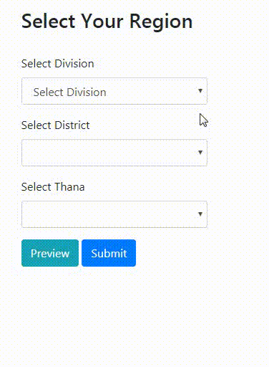
Related Select
Related select is usable in input form where any input value is dependent on another input value.
Example every division has district and every district has thana.
https://www.jqueryscript.net/form/Multilevel-Dependent-Dropdown-Plugin-With-jQuery-Dependent-Dropdowns.html
Dr. Md. Majharul Haque

Slide 7
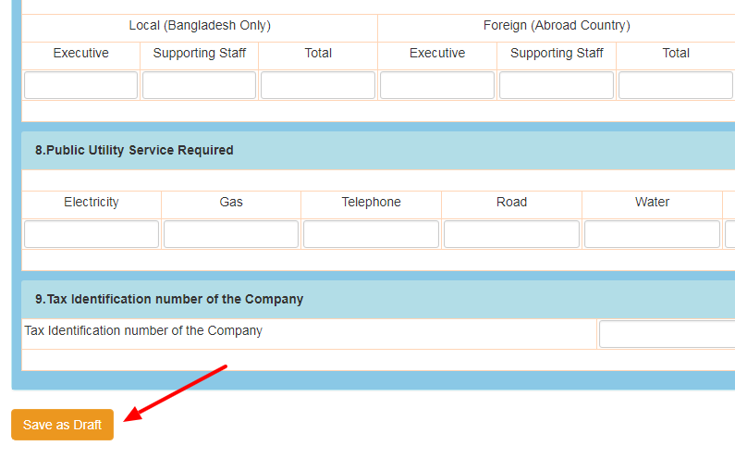
Form save as draft:
For example, in our email (Gmail or Yahoo), we can keep the email as a draft. When we will get time, we complete the email and then send. In the same way, our application form can be big also. We want to keep this partially complete and save as draft.
The draft button will work as like submit button but skip the form validation. And, there will be a flag to confirm that this form has been saved as a draft in the database. It can be edited and save as draft for multiple times. If you open this draft application, it will be opened in editable form always before the final submission.
i. https://www.tutorialspoint.com/laravel/laravel_forms.htm
ii. https://www.sitepoint.com/crud-create-read-update-delete-laravel-app/

Slide 8
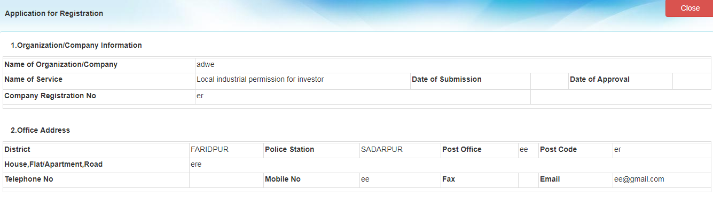
Form preview
Before final form submission it’s a good idea to show users what they have submitted.
Seeing the preview form user can cross check the input and if necessary the can change their input.

Slide 9
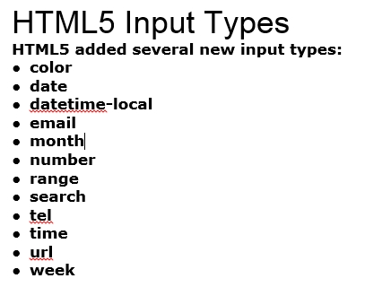

HTML5 Form Elements
HTML5 added the following form elements:
<datalist>
<output>
Note: Browsers do not display unknown elements. New elements that are not supported in older browsers will not "destroy" your web page.
Input Type Search
The <input type="search"> is used for search fields (a search field behaves like a regular text field).

Slide 10
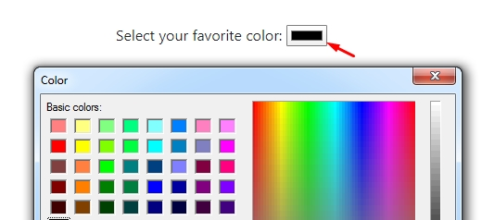
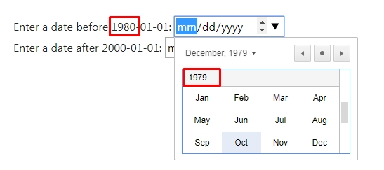
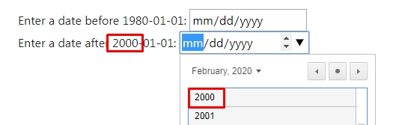
HTML5 Form Elements
Input Type Color
The <input type="color"> is used for input fields that should contain a color.
HTML5 added the following form elements:
<datalist>
<output>
Note: Browsers do not display unknown elements. New elements that are not supported in older browsers will not "destroy" your web page.
Input Type Date
The <input type="date"> is used for input fields that should contain a date.

Slide 11
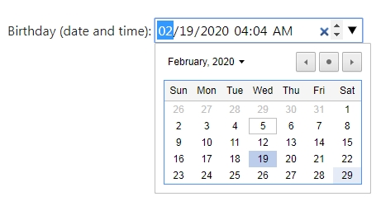
HTML5 Form Elements
Input Type Date
The <input type="date"> is used for input fields that should contain a date.
HTML5 added the following form elements:
<datalist>
<output>
Note: Browsers do not display unknown elements. New elements that are not supported in older browsers will not "destroy" your web page.
Input Type Datetime-local
The <input type="datetime-local"> specifies a date and time input field, with no time zone.

Slide 12
HTML5 Attributes
HTML5 Attributes
HTML5 added the following attributes for <input>:
autocomplete
autofocus
form
formaction
formenctype
formmethod
formnovalidate
formtarget
height and width
list
min and max
multiple
pattern (regexp)
placeholder
required
Step and the following attributes for <form>:
autocomplete
novalidate
HTML5 added the following form elements:
<datalist>
<output>
Note: Browsers do not display unknown elements. New elements that are not supported in older browsers will not "destroy" your web page.

Slide 13
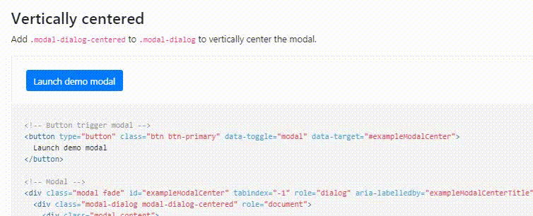
Bootstrap Component
Modal
Modal plugin to add dialogs to your site for lightboxes, user notifications, or completely custom content.
https://getbootstrap.com/
https://getbootstrap.com/docs/4.0/components/modal/

Slide 14
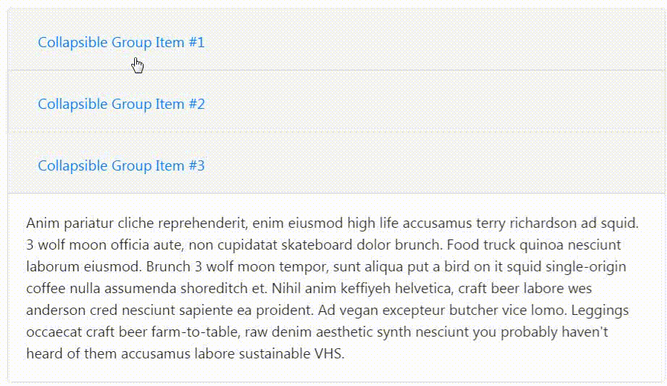
Bootstrap Component
Accordion - Expand/Collapse multiple sections
Expand and collapse all accordion sections with one click or have 4 different links to close each of the accordion divs.
https://jqueryui.com/accordion/
https://api.jqueryui.com/accordion/
https://getbootstrap.com/docs/4.3/components/collapse/

Slide 15
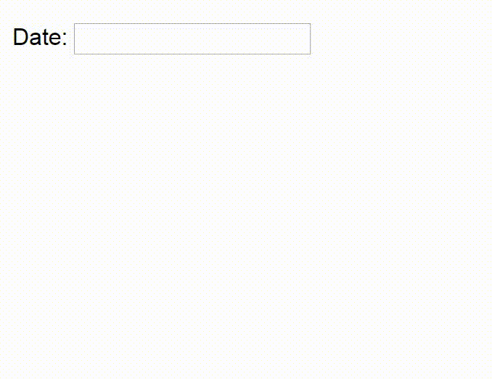
Javascript & Jquery Component
Datepicker
The datepicker is tied to a standard form input field. Focus on the input (click, or use the tab key) to open an interactive calendar in a small overlay. Choose a date, click elsewhere on the page (blur the input), or hit the Esc key to close. If a date is chosen, feedback is shown as the input's value.
https://bootstrap-datepicker.readthedocs.io/en/latest/
https://jqueryui.com/datepicker/
https://jqueryui.com/datepicker/

Slide 16
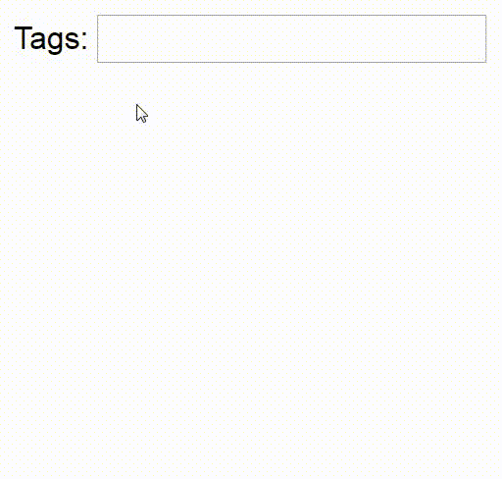
Javascript & Jquery Component
Autocomplete
jQuery Autocomplete function is called on the key-up event of the input field. This function requests PHP for the list of countries via AJAX by sending the value of the input field. In PHP, it reads country names from the database that starts with the keyword entered by the user.
Autocomplete feature is used to provide the auto suggestion for users while entering input. In this tutorial, we are going to suggest country names for the users based on the keyword they entered into the input field by using jQuery AJAX.
https://jqueryui.com/autocomplete/
https://phppot.com/jquery/jquery-ajax-autocomplete-country-example/

Slide 17
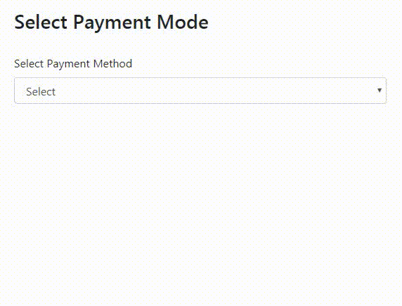
Javascript & Jquery Component
Conditional Field
Javascript component that shows and hides page elements based on form field values.
https://stevenwanderski.github.io/conditional-field/
https://stevenwanderski.github.io/conditional-field/#nav-examples

Slide 18
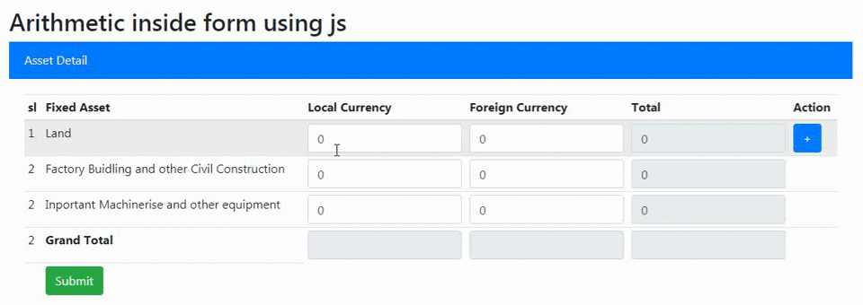
Arithmetic inside form using javascript
Arithmetic operation in form is a way to input form value easily and correctly.
In this process user does not needs to put all input value in input form. Some input field are automatically calculate the value by depending other input field.

Slide 19
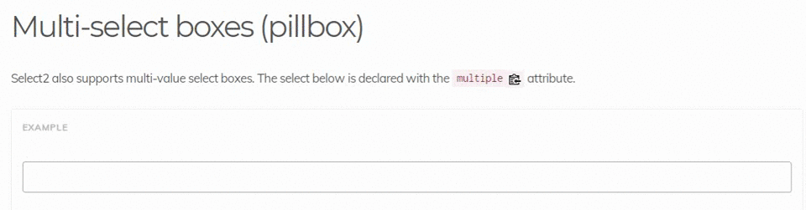
Select2 / Autocomplete plugins for dropdown list
Select2 jquery plugin gives you a customizable select box with support for searching, tagging, remote data sets, infinite scrolling, and many other highly used options.
https://select2.org/getting-started/basic-usage
https://select2.org/getting-started/basic-usage

Slide 20
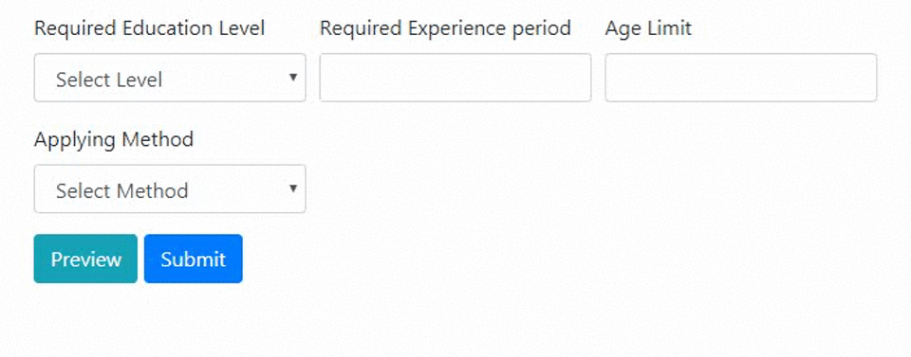
Show/hide portion of form conditionally
Some time user needs to configure input form as their requirement. So it’s the developer responsibility to design input form as customizable.
Using javascript and its framework developer can design a customizable form where user can add or remove input field for there requirement.
http://www.randomsnippets.com/2011/04/10/how-to-hide-show-or-toggle-your-div-with-jquery/

Slide 21
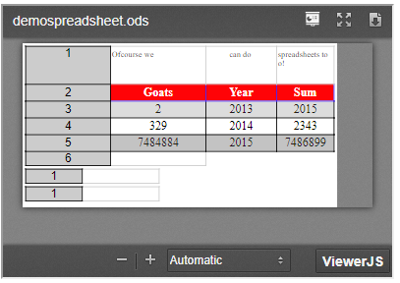
ViewerJS
ViewerJS is a combination of a number of excellent open source tools that are built on HTML and javascript.
https://viewerjs.org
https://viewerjs.org/examples/

Slide 22
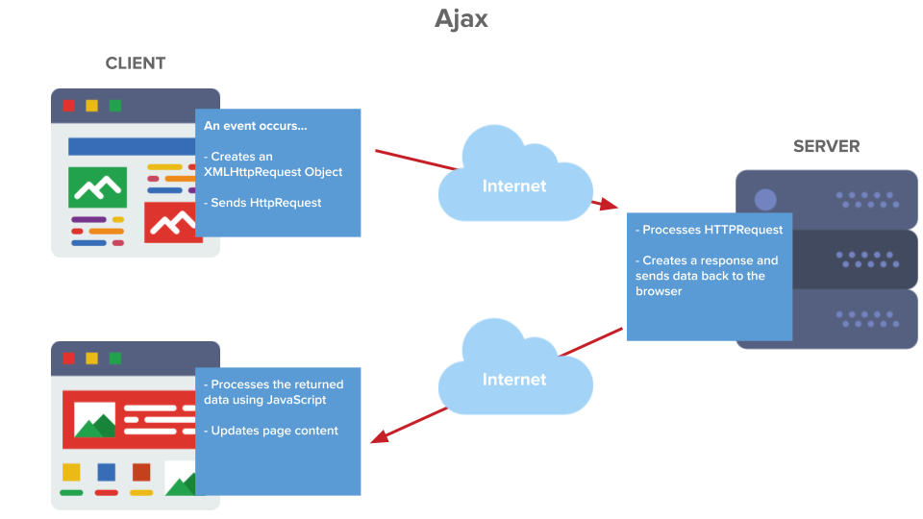
Ajax
Ajax is a set of web development techniques using many web technologies on the client side to create asynchronous web applications.
With Ajax, web applications can send and retrieve data from a server asynchronously without interfering with the display and behavior of the existing page
https://www.w3schools.com/jquery/tryit.asp?filename=tryjqu ery_ajax_ajax
https://www.tutorialspoint.com/laravel/laravel_ajax.htm

Slide 23
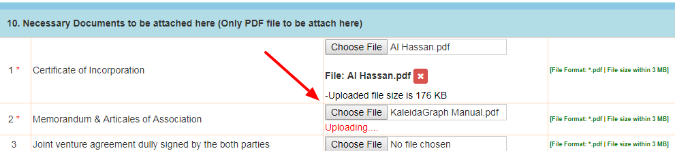
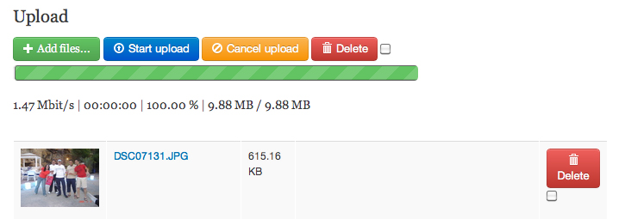
Image/File uploading using Ajax
In this process, the image is selected first to any location. Then using jQuery Ajax, it is sent to the php script on submit button event. PHP script stores the image in a defined location and returns the message of the success and failure of the process. Here we have applied some validations on the selected file, to check it whether it is an image file (jpg, jpeg or png ) or any other file type. Upload File size allowed is 100 Kb.
https://www.formget.com/ajax-image-upload-php/
https://www.formget.com/ajax-image-upload-php/

Slide 24
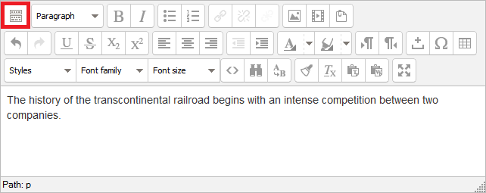
Text Editor- TinyMCE
Online
TinyMCE is an online rich-text editor released as open-source software under the LGPL. ... TinyMCE is designed to easily integrate with JavaScript libraries such as React (JavaScript library), Vue. js, and AngularJS as well as content management systems such as Joomla!, and WordPress.
https://www.tiny.cloud/
https://www.quackit.com/html/html_editors/tinymce_editor.cfm
https://www.dyclassroom.com/tinymce/how-to-setup-tinymce-text-editor

Slide 25
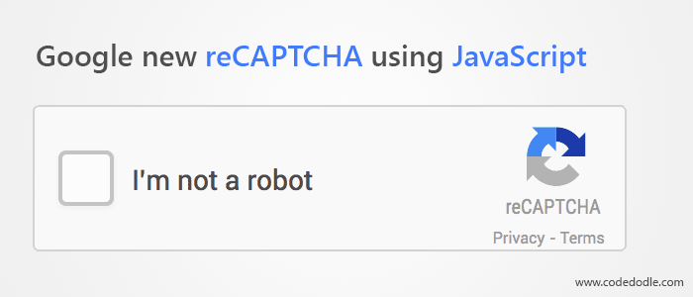
CAPTCHA
Captcha is a program used to protects websites through bots. It generates some tests that human can read and pass it but current computer cannot do. For example, humans can read distorted text but computer cannot read. The CAPTCHA is the abbreviation of Completely Automated Public Turing Test to Tell Computers and Humans Apart.
Web Link for example: Not needed
https://medium.com/@dennissmink/laravel-google-recaptcha-a0e2d8b2d03b

Slide 26

External HTML Component
Font Awesome
Get vector icons and social logos on your website with Font Awesome, the web's most popular icon set and toolkit.
https://fontawesome.com/icons
https://fontawesome.com/how-to-use/on-the-web/referencing-icons/basic-use

Slide 27
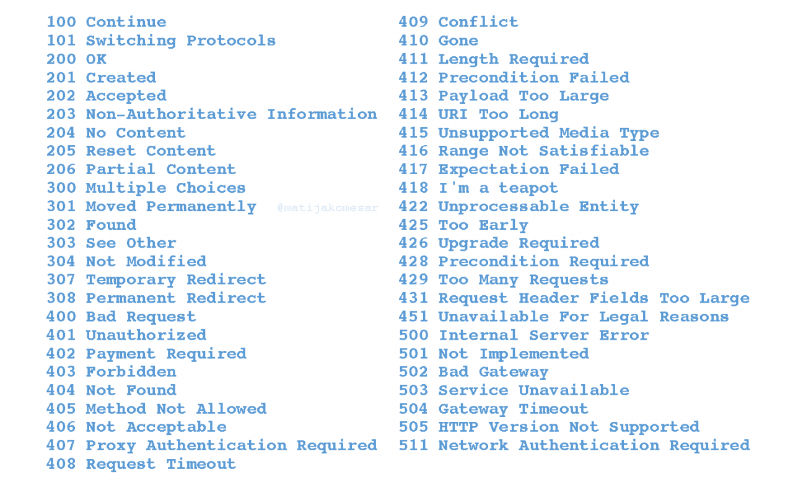
HTTP Response Status & Messages
When a browser requests a service from a web server, an error might occur.
This is a list of HTTP status messages that might be returned:
httpstatuscodes.html
https://developer.mozilla.org/en-US/docs/Web/HTTP/Status

Slide 28
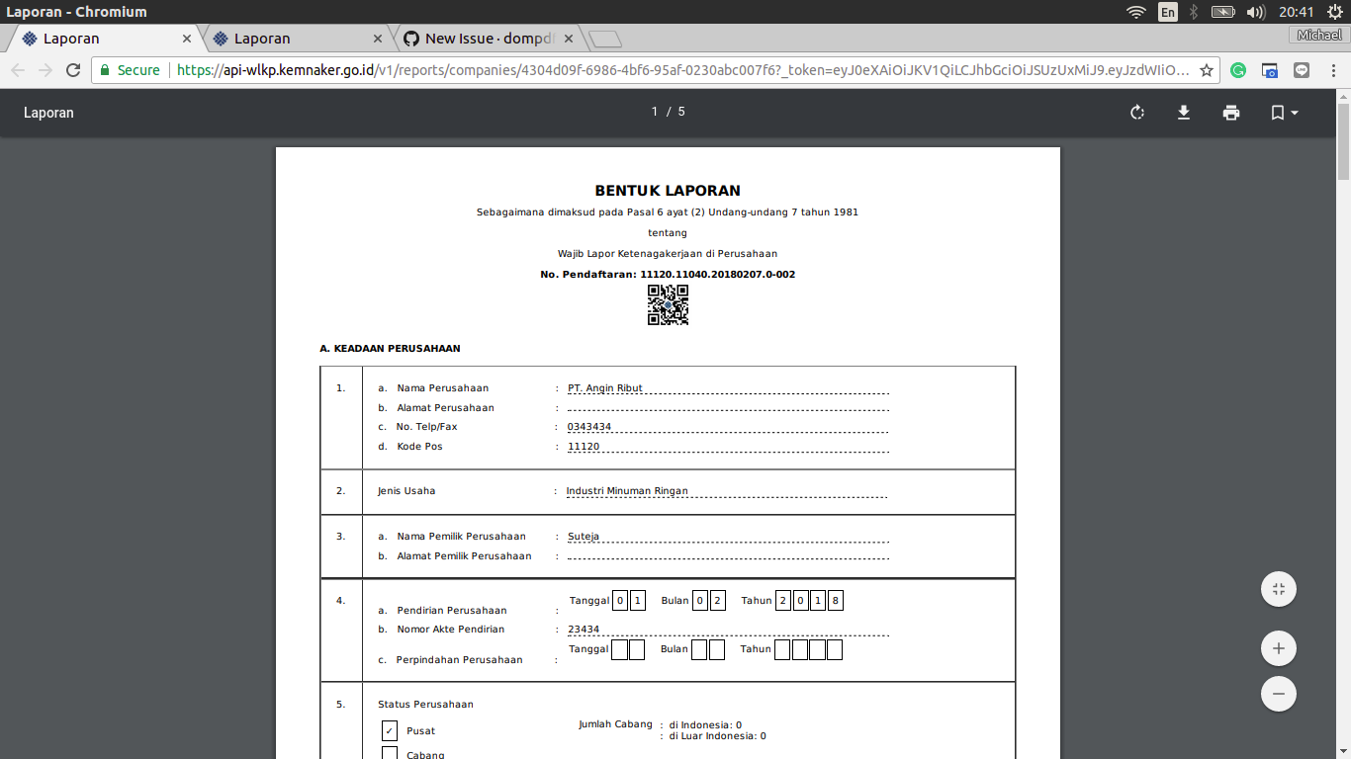

Dynamic PDF Building using PHP (mpdf or dompdf)
dompdf is an HTML to PDF converter. At its heart, dompdf is (mostly) CSS 2.1 compliant HTML layout and rendering engine written in PHP.
It is a style-driven renderer: it will download and read external stylesheets, inline style tags, and the style attributes of individual HTML elements. It also supports most presentational HTML attributes.
https://github.com/kartik-v/yii2-mpdf
https://github.com/dompdf/dompdf
https://github.com/barryvdh/laravel-dompdf

Slide 29
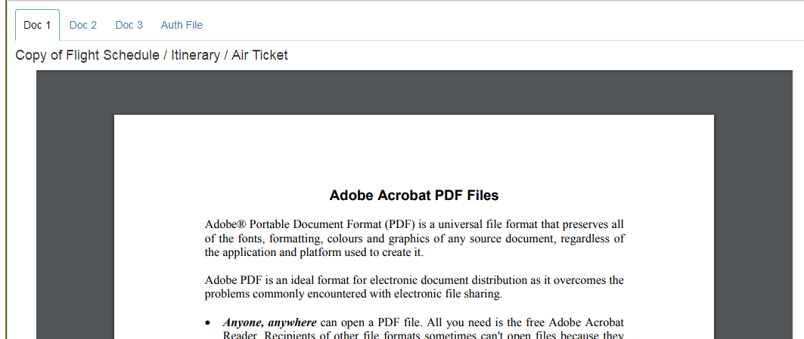
PDF Viewer
The <object> tag defines an embedded object within an HTML document. Use this element to embed multimedia (like audio, video, Java applets, ActiveX, PDF, and Flash) in your web pages.
You can also use the <object> tag to embed another webpage into your HTML document. You can use the <param> tag to pass parameters to plugins that have been embedded with the <object> tag.
https://www.w3schools.com/tags/tag_object.asp
https://www.w3schools.com/tags/tag_object.asp

Slide 30
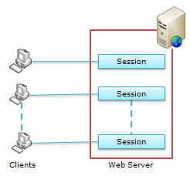
Session
When you work with an application, you open it, do some changes, and then you close it. This is much like a Session.
The computer knows who you are. It knows when you start the application and when you end. But on the internet, there is one problem: the web server does not know who you are or what you do, because the HTTP address doesn't maintain state.
Session variables solve this problem by storing user information to be used across multiple pages (e.g. username, favorite color, etc).
By default, session variables last until the user closes the browser. So; Session variables hold information about one single user, and are available to all pages in one application.
https://www.w3schools.com/php/php_sessions.asp
https://www.w3schools.com/php/php_sessions.asp
https://laravel.com/docs/5.1/session

Slide 31
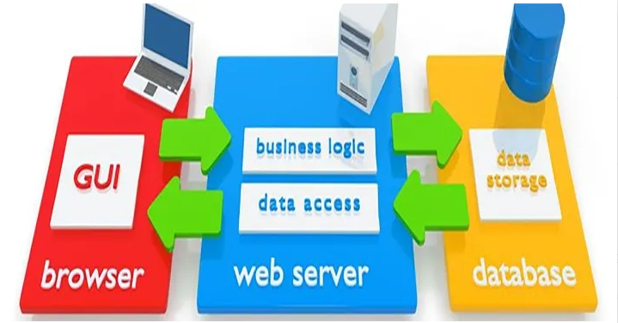

Database Operations
MySQL is an open-source relational database management system.
https://www.w3schools.com/php/php_mysql_connect.asp
https://www.w3schools.com/php/php_mysql_create.asp
https://www.w3schools.com/php/php_mysql_create_table.asp
https://www.w3schools.com/php/php_mysql_insert.asp
https://www.w3schools.com/php/php_mysql_insert_lastid.asp
https://www.w3schools.com/php/php_mysql_insert_multiple.asp
https://www.w3schools.com/php/php_mysql_prepared_statements.asp
https://www.w3schools.com/php/php_mysql_select.asp
https://www.w3schools.com/php/php_mysql_select_where.asp
https://www.w3schools.com/php/php_mysql_select_orderby.asp
https://www.w3schools.com/php/php_mysql_delete.asp
https://www.w3schools.com/php/php_mysql_update.asp
https://www.w3schools.com/php/php_mysql_update.asp
http://www.mysqltutorial.org/
https://www.tutorialspoint.com/mysql/index.htm
The data in a MySQL database are stored in tables. A table is a collection of related data, and it consists of columns and rows.

Slide 32
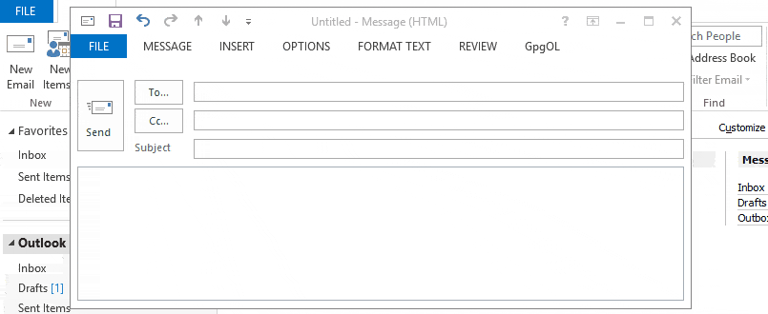
Different types of email sending (With attachment cc, bcc).

Slide 33
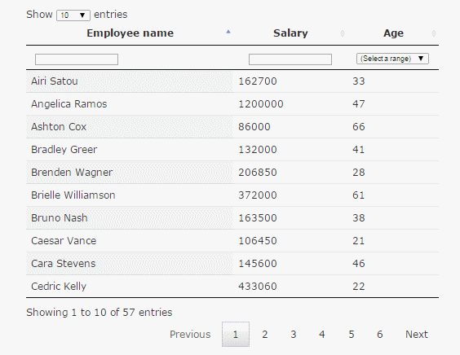
Data tables plugins
DataTables is a plug-in for the jQuery Javascript library. It is a highly flexible tool, built upon the foundations of progressive enhancement, that adds all of these advanced features to any HTML table.
https://datatables.net/
https://github.com/yajra/laravel-datatables

Slide 34
Some advanced components and features
Cron job
External Login API
Authentication and Authorization
Payment Gateway Integration
Git Command and Bitbucket

